Slide 1
Notes:
[Note: It is not allowed to use the integrated pictures in another context than in this presentation . They mustn’t be extracted / used / distributed in another way. Please contact AXOR Marketing for further details.]

Slide 2
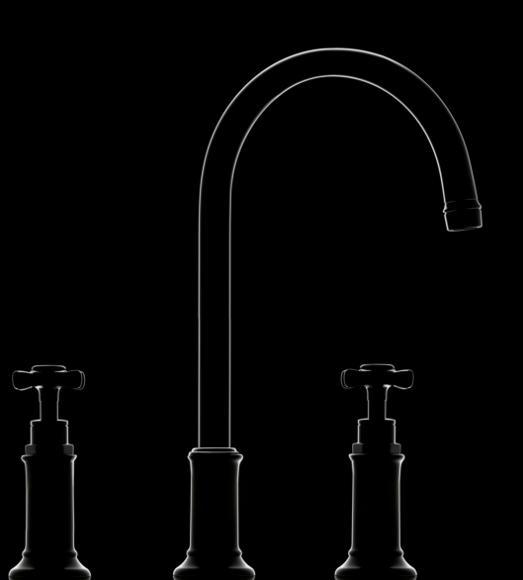
AXOR MONTREUX
Notes:
Welcome to the AXOR Montreux presentation.
Here you are getting to know the AXOR Montreux news, which will be available in 2017.

Slide 3
AUTHENTICITY. IN PERFECTION.
AXOR MONTREUX .
At the turn of the century a new era of economic prosperity, technology and cultural innovations arose, later called the Bell Epoque era. The designs of this era have been forever immortalized in the grand hotels of Europe and epically at Montreux, the legendary spa resort at Lake Geneva Switzerland.
Edison invents the light bulb (1879)
The Orient-Express connects Paris and Constantinople (1883)
Carl Benz: First automobile with a
combustion engine (1886)
Fairmont Le Montreux Palace, Lake Geneva Switzerland (1906)
Eiffel Tower (construction 1887– 1889)
Notes:
At the turn of the century a new era of economic prosperity, technology and cultural innovations arose, later called the Bell Epoque era. The designs of this era have been forever immortalized in the grand hotels of Europe and epically at Montreux, the legendary spa resort at Lake Geneva Switzerland.

Slide 4
AUTHENTICITY. IN PERFECTION.
AXOR MONTREUX .
AXOR Montreux collection is steeped in the same traditions of the Bell Époque era. Mixers, showers and accessories in the design of the first ever industrially manufactured bathroom fixtures. Classic low-spout or modern high spout design, In combination with outstanding technology and functionality, with no compromises in perfection.
Notes:
AXOR Montreux collection is steeped in the same traditions of the Bell Époque era. Mixers, showers and accessories in the design of the first ever industrially manufactured bathroom fixtures. Classic low-spout or modern high spout design. In combination with outstanding technology and functionality. With no compromises. In perfection.

Slide 5
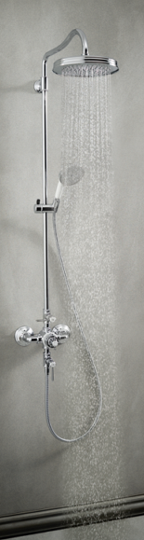
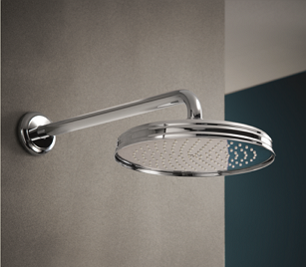
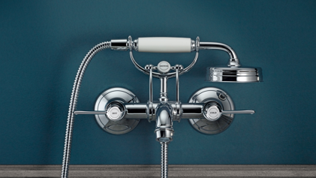
PERFECTION IN TRADITIONAL DESIGN
AXOR MONTREUX .
AXOR MONTREUX
+ Complete collection
+ Consistent, unique design language
INSPIRED BY
BELLE ÉPOQUE
Notes:
AXOR Montreux is a complete collection for all areas in the bathroom with a broad product range consisting out of mixers, showers and accessories

Slide 6
PERFECTION IN TRADITIONAL DESIGN
AXOR MONTREUX .
AXOR MONTREUX
+ Complete collection
+ Consistent, unique design language
+ Authentic, additive execution
Reference to early 20th century
INSPIRED BY
BELLE ÉPOQUE
Notes:
The execution is very authentic and additive.
[click] Additive means, that the faucets consist out of various single parts and not just one piece [<> higher complexity in production >> more authentic!! Only manual assembly possible!!]. This is a very strong reference to the first industrially produced mixers at the end of the 19th century and making it very valuable.

Slide 7
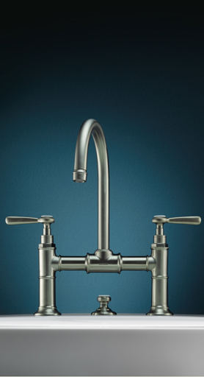
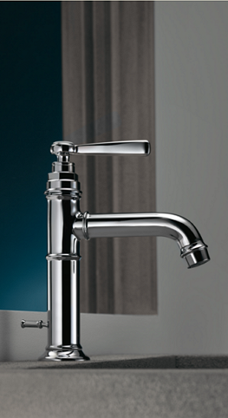
PERFECTION IN TRADITIONAL DESIGN
AXOR MONTREUX .
AXOR MONTREUX
+ Complete collection
Harmonious proportions
Decorative elements
Modern interpretation
+ Consistent, unique design language
+ Authentic, additive execution
+ Elegant appearance
INSPIRED BY
BELLE ÉPOQUE
Notes:
Along with the very harmonious proportions,
the fine subtle play of decorative elements and
a modern interpretation of the traditional design (especially high spout),
AXOR Montreux is precious and has a bespoken and elegant overall appearance …

Slide 8
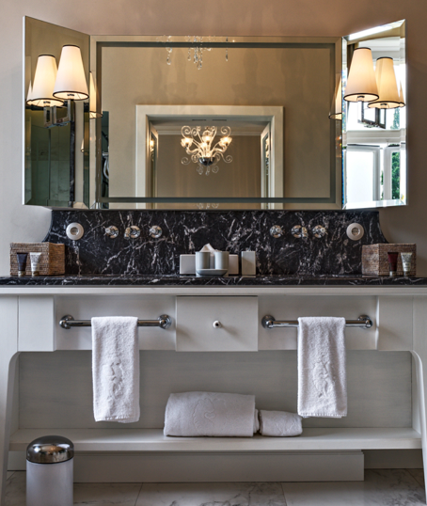
PERFECTION IN TRADITIONAL DESIGN
AXOR MONTREUX .
AXOR MONTREUX
+ Complete collection
Traditional
Modern
+ Consistent, unique design language
+ Authentic, additive execution
+ Elegant appearance
+ Fits to traditional and modern interiors
INSPIRED BY
BELLE ÉPOQUE
Notes:
… for traditional and modern interiors (as a counterpart).
[Additional info: We already emphasized and showed the usage of a traditional product in a modern setting in 2006 … this was also a very forward thinking approach in this time <> mixed styles. Today this idea has become an interior attitude as we see it often in magazines or private houses where people due to the aim of being more individualistic tend to mix … old and new, bought and inherited, … . Keep that in mind, because this is one facet where we see more sales potential for AXOR Montreux.]

Slide 9
PERFECTION IN TRADITIONAL DESIGN
AXOR MONTREUX .
AXOR MONTREUX
+ Complete collection
+ Consistent, unique design language
+ Authentic, additive execution
+ Elegant appearance
+ Fits to traditional and modern interiors
+ Comfortable, great water experience
State-of-the-art water technology
inside
INSPIRED BY
BELLE ÉPOQUE
Notes:
To match our high standards in terms of a comfortable and conscious water experience for the user, we integrated most state-of-the-art water technology.

Slide 10
PERFECTION IN TRADITIONAL DESIGN
AXOR MONTREUX .
PHOENIX DESIGN
AXOR MONTREUX
+ Complete collection
+ Consistent, unique design language
+ Authentic, additive execution
+ Elegant appearance
+ Fits to traditional and modern interiors
+ Comfortable, great water experience
INSPIRED BY
BELLE ÉPOQUE
Notes:
The design was developed together with Phoenix design
[Additional info: Phoenix Design is regarded as the leading independent product and interface design studio in the world. For many years now, Phoenix Design has been defending the Number One rank at the “iF Ranking Creative” at the iF Design Award as best external “Design Offices” with 700 Design Awards, since 1987. According to the founders Tom Schönherr and Andreas Haug the idea to found Phoenix design was born on a sailing trip in 1986 . On Klaus Grohes sailing boat. This was the basis for nearly three decades of joint history. For more information on Phoenix desgin see: http://www.phoenixdesign.com/ ]

Slide 11
SINGLE-HOLE FAUCETS
AXOR MONTREUX .

Slide 12
SINGLE-HOLE FAUCET
AXOR MONTREUX .
+ Two versions
Chrome
Brushed nickel
Polished nickel
SINGLE-HOLE FAUCET
SINGLE-HOLE FAUCET, TALL
Notes:
Lets look at our new key products: The single-hole lever basin mixers. We have two basic versions.
By adding single lever mixers we are closing the biggest gap in the existing range and we are providing very interesting sales potential for our customers.
We offer AXOR Montreux in three standard surfaces – Chrome, brushed nickel, and polished nickel (will be available ex stock).

Slide 13
SINGLE-HOLE FAUCET
AXOR MONTREUX .
+ Fits to numerous situations
+ ComfortZone
+ Authentic design and execution
Chrome $615
Brushed nickel
ComfortZone 4 inches
Polished
nickel
Notes:
Lets look at the first Single-hole faucet. It is a compact traditional statement.
With its well-proven height it is the ideal solution for numerous installations situations.
It offers an attractive ComfortZone of 4 inches beneath the spout.
As you can see, the design and execution is to 100 % AXOR

Slide 14
SINGLE-HOLE FAUCET
AXOR MONTREUX .
+ Fits to numerous situations
Porcelain cover caps
+ ComfortZone
Ergonomic handle
+ Authentic design and execution
+ Easy and convenient operation
Soft and slim
+ Nice to the touch
Well-balanced proportions
+ Elegant appearance
Chrome
+ Self-explaining in use
Brushed nickel
Polished
nickel
Notes:
The conical reduced handle is ergonomic, enabling an easy and convenient operation even with wet or soapy hands.
With the soft rounding it is nice to the touch but at the same time due to the well balanced proportions and slim shape it appears very elegant, very precious.
The fine porcelain cover caps emphasize the traditional character plus, with the integrated functional marking, the usage becomes even more self-explaining … at home or for first time users in hotels.

Slide 15
SINGLE-HOLE FAUCET
AXOR MONTREUX .
+ Fits to numerous situations
M25 ceramic cartridge
+ ComfortZone
+ Authentic design and execution
+ Easy and convenient operation
+ Nice to the touch
+ Elegant appearance
Normal spray 1.2 GPM
Chrome
+ Self-explaining in use
QuickClean
Brushed nickel
+ Precise, comfortable temperature adjustment
Polished
nickel
+ Savings (energy / water)
Notes:
Regarding the water functions / technology especially the M25 ceramic cartridge should be highlighted.
This ceramic mixing system makes the temperature adjustment comfortable and precise.
Temperature limitation is adjustable, offering additional safety or energy savings e.g. in hotels.
The faucet is fitted with laminar spray with a flow rate of 1.2 GPM and QuickClean cleaning function.
Below the line our mixers provide a maximized comfort in use at the basin.

Slide 16
SINGLE-HOLE FAUCET, TALL
AXOR MONTREUX .
+ Fits to numerous situations
+ Maximized ComfortZone
+ Authentic design and execution
+ Easy and convenient operation
Laminar 1.2 GPM
Swiveling spout 120°
+ Nice to the touch
+ Elegant appearance
Chrome
+ Self-explaining in use
ComfortZone 8 ¼ inches
Brushed nickel
+ Precise, comfortable temperature adjustment
Polished
nickel
+ Savings (energy / water)
Notes:
In contrary to the first faucet,
the Single-Hole Faucet Tall is an ideal solution for anyone searching for a traditional single lever basin mixer with a maximized ComfortZone.
All other features and advantages correspond to the first Single-Hole faucet
except the laminar spray (single lever basin mixer 100 has the normal spray)
[click] and except the 120° swiveling spout,
providing additional comfort in use.

Slide 17
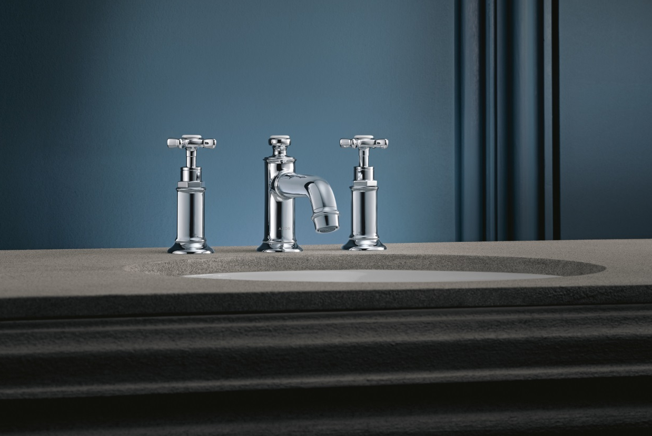
WIDESPREAD FAUCETS, LOW SPOUT
AXOR MONTREUX .

Slide 18
WIDESPREAD FAUCET, LOW SPOUT
AXOR MONTREUX .
+ Low height
Chrome $800
Brushed nickel
1 inch
Polished
nickel
Notes:
Another new option: The Widespread Faucet with Low Spout
With its low height this product is a very clever extension to the existing range especially for
built-in-washbasins and bath cabinets
which is a very common and requested option in hotels.

Slide 19
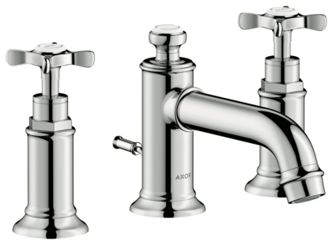
WIDESREAD FAUCET, LOW SPOUT
AXOR MONTREUX .
+ Low height
+ Lever or Cross handles
Chrome
Brushed nickel
Polished
nickel
Notes:
The Low Spout Widespread Faucet is available with cross handles AND with lever handles giving your customers (and their customers) the freedom of choice –
regarding taste (more traditional, traditional) and
using preferences (turning versus sliding).

Slide 20
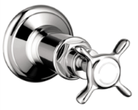
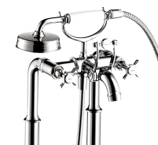
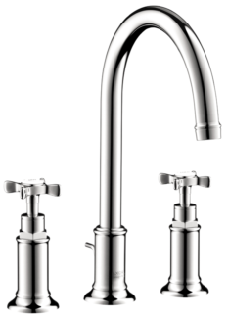
AXOR MONTREUX .
CROSS HANDLE
LEVER HANDLE
+ Lever and Cross handles to match all corresponding fixtures.
Notes:
AND FROM 2017 on we are offering existing AXOR Montreux products with cross handles AND
lever handles as mentioned an attractive added value in terms of clever and easy individualization option (taste and user preferences) .

Slide 21
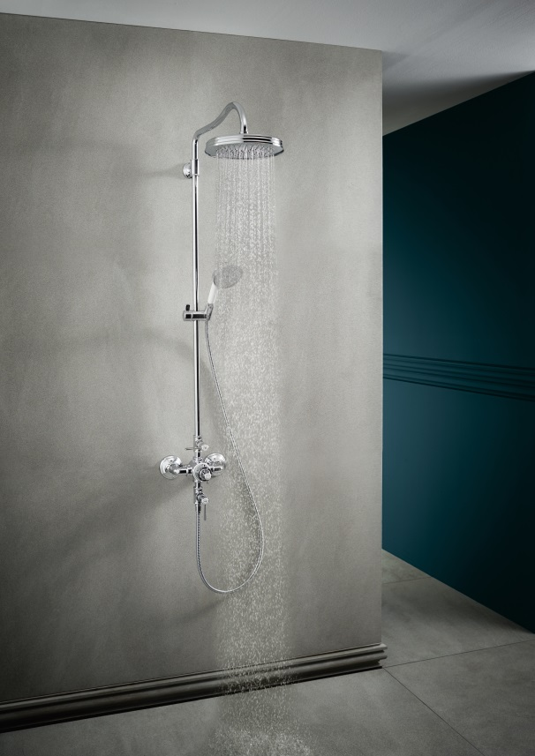
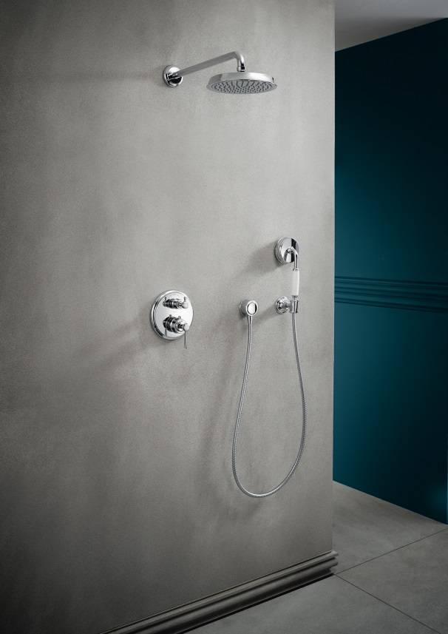
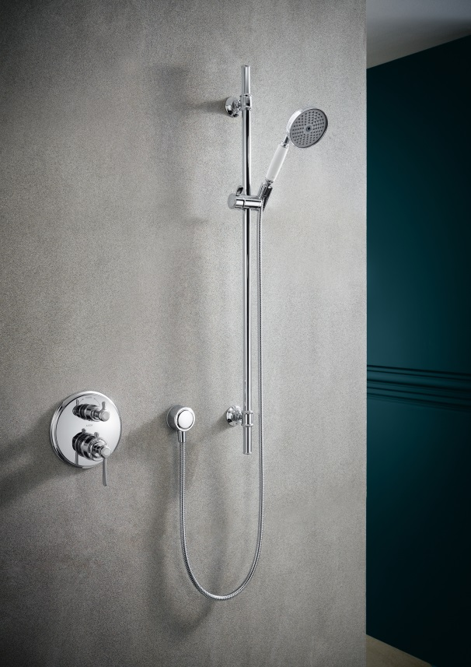
SHOWERPIPE, SHOWER TRIMS, SHOWER HEADS AND HAND SHOWERS
AXOR MONTREUX .

Slide 22
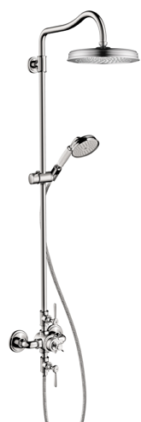
SHOWERPIPE
AXOR MONTREUX .
+ Simplified, self-explaining usage
REDESIGN
+ Thermostatic mixer
+ Separate volume control for hand shower and shower head. (Can be used together for sharing feature. See instruction manual to make California Energy Commission compliant.)
Valve for the overhead shower
Chrome $2400
Thermostatic mixer
Brushed nickel
Valve for the handshower
Polished
nickel
Notes:
We have redesigned our Showerpipe with thermostatic mixer and 1jet overhead shower. Why? Mainly because we wanted to simplify the usage to make it self-explaining and along with that … more interesting / attractive for the project business.
We achieved our goal by a clear separation and positioning of the functions.
The valve for the overhead shower is located at the riser pipe (upper position)
The thermostatic temperature control is in the center
The valve for the hand shower is located at the hose connection (lower position)

Slide 23
SHOWERPIPE
AXOR MONTREUX .
+ Simplified, self-explaining usage
REDESIGN
Swivel shower arm
+ Swivel shower arm
+ Height adjustable hand shower
Slider for the hand shower
Hand shower usable as shoulder and / or body spray.
Chrome
Brushed nickel
Polished
nickel
Notes:
The second reason was, that we wanted to increase the shower comfort by integrating a swivel shower arm at the overhead shower and a slider for the handshower. As you all know the swiveling shower arm is a nice function when soaping yourself or if you want to be sure that you don’t stand under the cold water when you turn on the shower. Not only first time users will appreciate that feature. ;-)
The integrated slider enables you to use the handshower as shoulder and / or body spray.

Slide 24
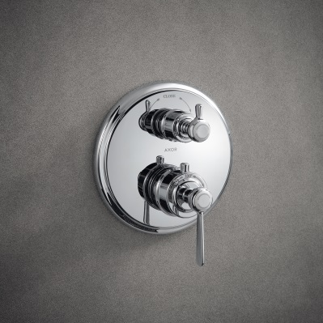
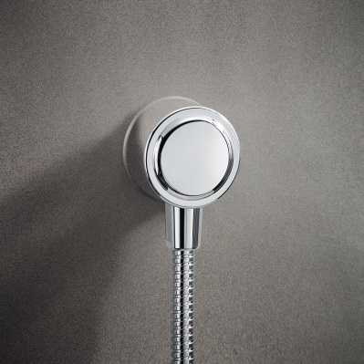
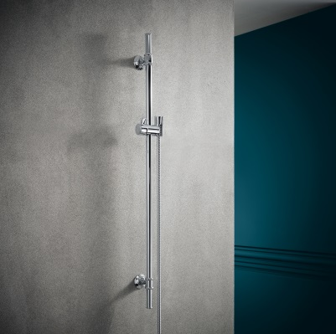
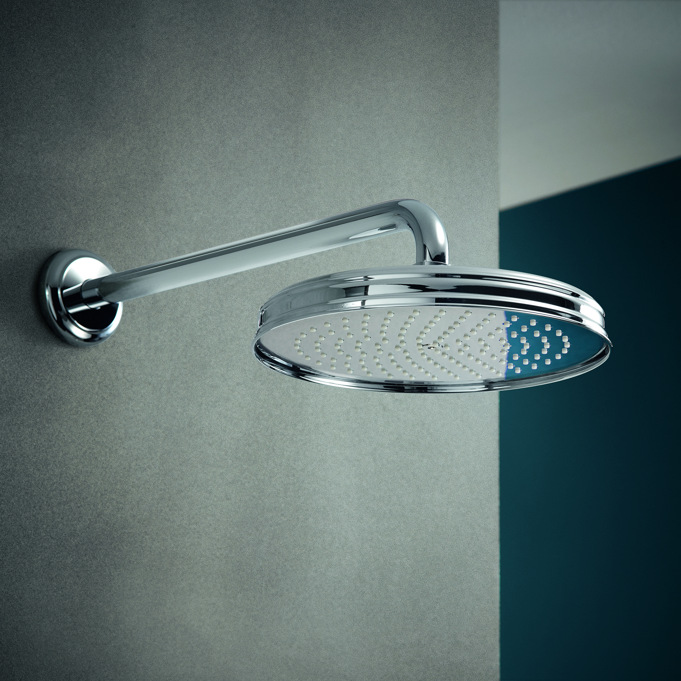
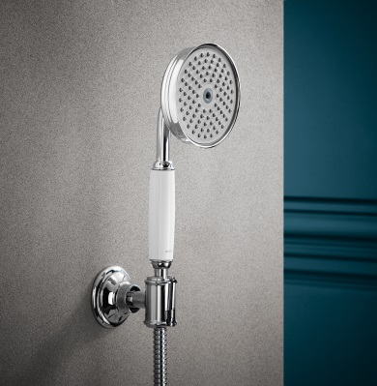
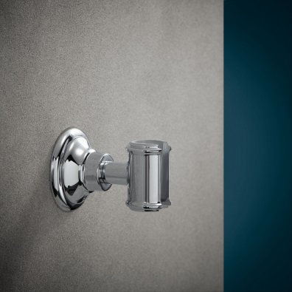
SHOWER TRIMS, SHOWER HEADS AND HAND SHOWERS
AXOR MONTREUX .
+ Showering products that match the design of AXOR Montreux faucets.

Slide 25
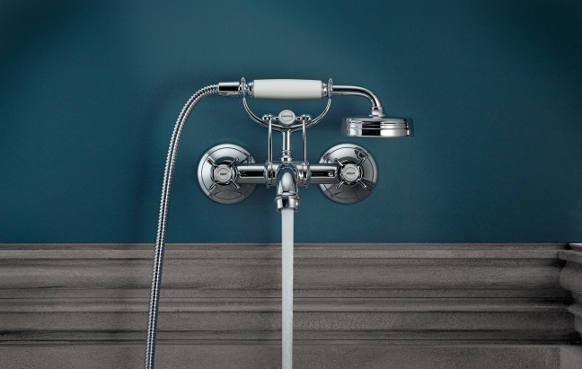
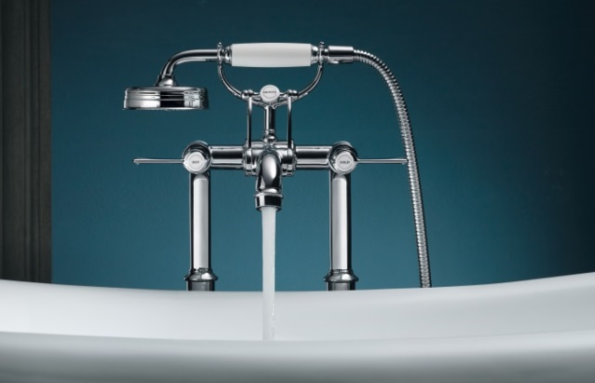
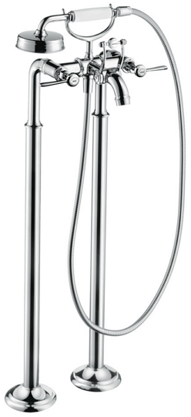
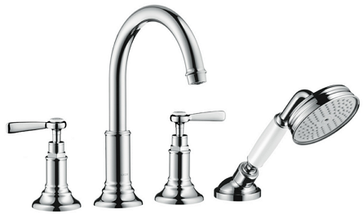
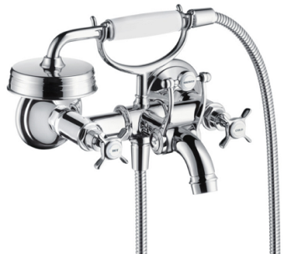
AXOR MONTREUX TUB FILLERS
AXOR MONTREUX .

Slide 26
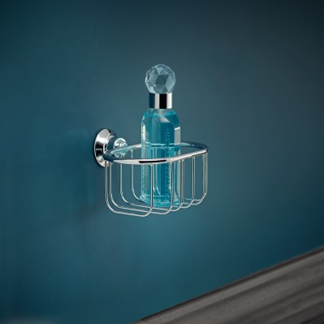
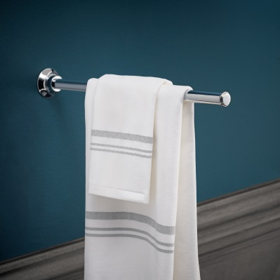
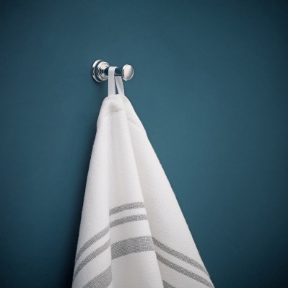
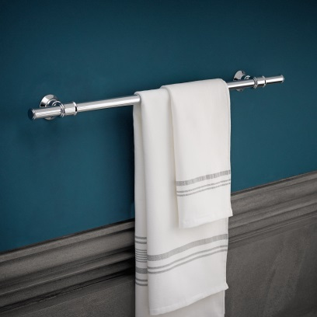
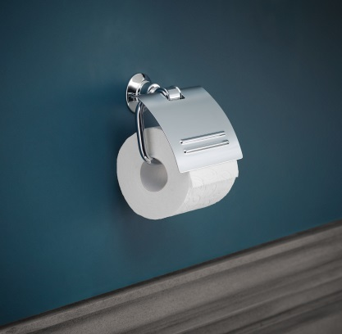
AXOR MONTREUX ACCESSORIES
AXOR MONTREUX .
Notes:
Axor Montreux also includes a matching line of accessories.

Slide 27
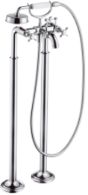
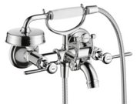
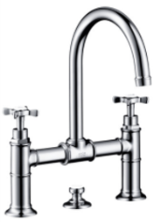
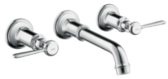
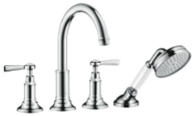
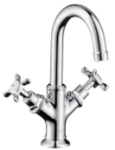
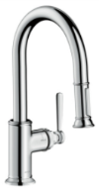
Pricing is not final!
AXOR MONTREUX .
SHOWERPIPE
TUB FILLERS
BASIN MIXERS
$1,600
$3,550
$2,150
$625
$1,420
$840
KITCHEN MIXERS
$2,400
$800
$685
$620
$600
$720
$780
$1,050
Notes:
Given prices are for products in chrome. As mentioned, all products are available in brushed nickel and polished nickel.
In terms of the price positioning: AXOR Montreux has a very attractive pricing. Regarding the new products we are making it very simple for our customers. Choosing lever handles instead of cross handles does not change the price.
The D2 prices for the kitchen products are:
SINGLE LEVER KITCHEN MIXER 400 Euro
SINGLE LEVER KITCHEN MIXER WITH PULL-OUT SPRAY 500 Euro
SINGLE LEVER KITCHEN MIXER SEMI-PRO 600 Euro

Slide 28
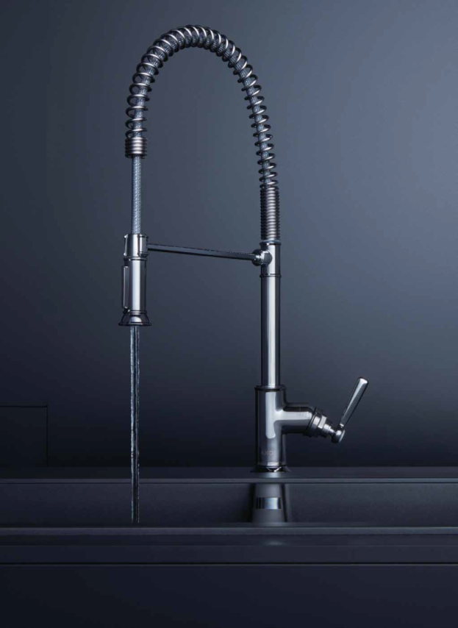
AXOR MONTREUX KITCHEN
AXOR MONTREUX .

Slide 29
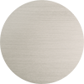
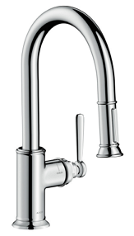
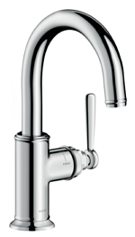
AXOR MONTREUX KITCHEN RANGE
AXOR MONTREUX .
+ Four versions
Chrome
Stainless Steel Optic
Polished Nickel
+ Authentic design and execution
+ Comfortable use
BAR FAUCET
2-SPRAY PREP KITCHEN FAUCET, PULL-DOWN
2-SPRAY HIGHARC KITCHEN FAUCET, PULL DOWN
2-SPRAY SEMI-PRO KITCHEN FAUCET
Notes:
Especially in the private segment this is a great cross-selling ability to realize a consistent interior design concept and / or to realize additional sales potential with new clients.
The products convince by the authentic, additive design and execution
leading to the traditional precious and elegant AXOR Montreux charm in combination with
innovative / best / modern water technology for most comfortable use.
Let’s look at the details.

Slide 30
KITCHEN FAUCET WITH PULL-OUT SPRAY
AXOR MONTREUX .
+ Authentic design and execution
Chrome
Brushed nickel
+ Comfortable use
Polished
nickel
Flow rate 1.75 GPM
Swivel spout range (110°/150°)
Integrated pullout spray
MagFit magnetic docking
ComfortZone 7 inches
Notes:
The Swivel range of the Kitchen Faucet with pull-out spray is 110°/ 150°.
The big difference is – as the name says – the pull-out spray which has MagFit magnetic sprayhead docking.
The Function is very comfortable and easy: Normal and spray jet + Lockable shower spray, spray returns through pressing spray diverter
[The flow Rate is at 1.75 GPM

Slide 31
SINGLE LEVER KITCHEN MIXER SEMI-PRO
AXOR MONTREUX .
+ Authentic design and execution
Chrome
Stainless steel spring
+ Comfortable use
Brushed nickel
Polished
nickel
Flow rate 1.75 GPM
Swivel spout range 360°: ideal for double sinks or islands
Integrated spray
ComfortZone 7 $7/8$inches
Notes:
The last one: our semi-pro version with Swivel range of 360°.
The kitchen mixer swivels right around. Great for double sinks – and for sink units integrated into the kitchen as island solutions.
The stainless steel spring makes the spout extremely mobile … leading to maximized functionality and comfort in use – just think of how easy it is to clean / spray a large cooking pot.
The function of the integrated spray is very comfortable and easy: Normal and spray jet + Lockable shower spray, spray returns through pressing spray diverter.
The flow Rate is at 1.75 GPM.

Slide 32
Thank you!

